Slide 1
Concurrency Control

Slide 2
Introduction
In a multi-user system, multiple users can access and use the same database at one time, which is known as the concurrent execution of the database. It means that the same database is executed simultaneously on a multi-user system by different users.
While working on the database transactions, there occurs the requirement of using the database by multiple users for performing different operations, and in that case, concurrent execution of the database is performed.

Slide 3
Introduction
the simultaneous execution that is performed should be done in an interleaved manner, and no operation should affect the other executing operations, thus maintaining the consistency of the database. Thus, on making the concurrent execution of the transaction operations, there occur several challenging problems that need to be solved.

Slide 4
The conflict?
DB operations are
Read
Write
Concurrent access is quite easy if all users are just reading data. There is no way they can interfere with one another. Though for any practical Database, it would have a mix of READ and WRITE operations and hence the concurrency is a challenge.

Slide 5
Potential problems of concurrency
Lost Updates occur when multiple transactions select the same row and update the row based on the value selected
Uncommitted dependency issues occur when the second transaction selects a row which is updated by another transaction (dirty read)
Non-Repeatable Read occurs when a second transaction is trying to access the same row several times and reads different data each time.
Incorrect Summary issue occurs when one transaction takes summary over the value of all the instances of a repeated data-item, and second transaction update few instances of that specific data-item. In that situation, the resulting summary does not reflect a correct result.

Slide 6
Lost Update problem(W-W Conflict)
The problem occurs when two different database transactions perform the read/write operations on the same database items in an interleaved manner (i.e., concurrent execution) that makes the values of the items incorrect hence making the database inconsistent.

Slide 7
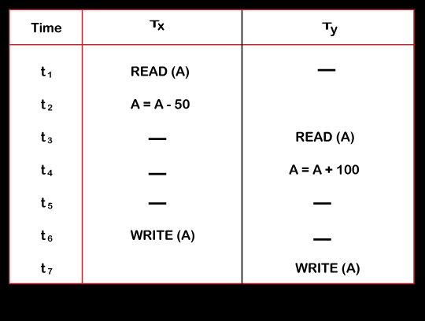
Lost Update Problem(w-w conflict)
Consider the below diagram where two transactions T_{X} and T_{Y}, are performed on the same account A where the balance of account A is $300.

Slide 8
Dirty Read problem(W-R conflict)
The dirty read problem occurs when one transaction updates an item of the database, and somehow the transaction fails, and before the data gets rollback, the updated database item is accessed by another transaction. There comes the Read-Write Conflict between both transactions.

Slide 9
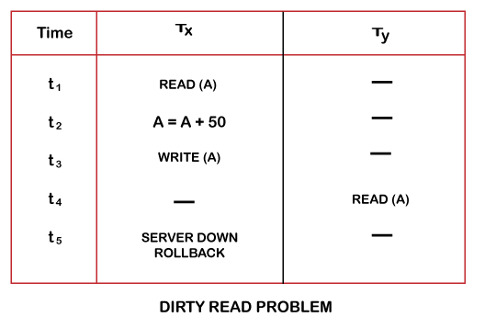
W-R Conflict
Consider two transactions T_{X} and T_{Y} in the below diagram performing read/write operations on account A where the available balance in account A is $300:

Slide 10
Unrepeatable read problem(W-R conflict)
Also known as Inconsistent Retrievals Problem that occurs when in a transaction, two different values are read for the same database item.

Slide 11
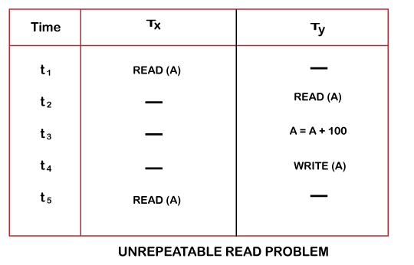
Unrepeatable read problem

Slide 12
Incorrect summary problem
Consider a situation, where one transaction is applying the aggregate function on some records while another transaction is updating these records. The aggregate function may calculate some values before the values have been updated and others after they are updated.

Slide 13
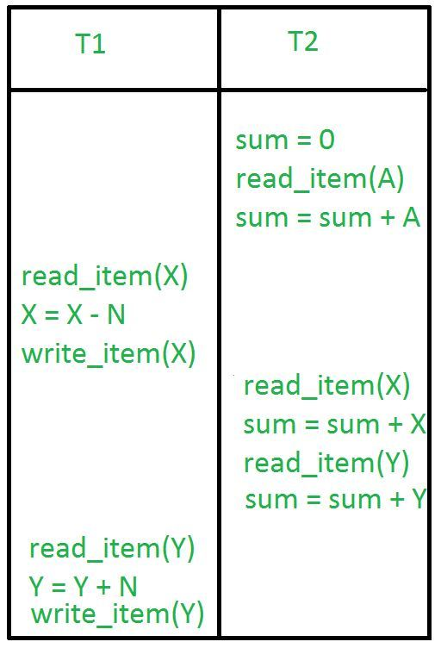
transaction 2 is calculating the sum of some records while transaction 1 is updating them. Therefore the aggregate function may calculate some values before they have been updated and others after they have been updated.

Slide 14
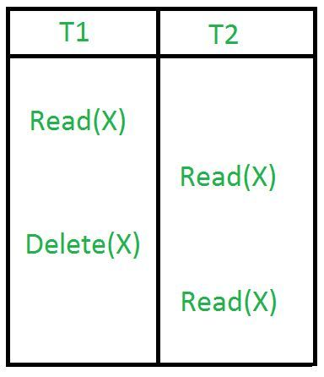
Phantom Read

Slide 15
Why use concurrency methods
Reasons for using Concurrency control method is DBMS:
To apply Isolation through mutual exclusion between conflicting transactions
To resolve read-write and write-write conflict issues
To preserve database consistency through constantly preserving execution obstructions
The system needs to control the interaction among the concurrent transactions. This control is achieved using concurrent-control schemes.

Slide 16
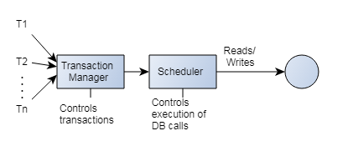

Slide 17
Concurrency protocols
Different concurrency control protocols offer different benefits between the amount of concurrency they allow and the amount of overhead that they impose. Following are the Concurrency Control techniques in DBMS:
Lock-Based Protocols
Two Phase Locking Protocol
Timestamp-Based Protocols
Validation-Based Protocols

Slide 18
Lock Based Protocol
Lock Based Protocols in DBMS is a mechanism in which a transaction cannot Read or Write the data until it acquires an appropriate lock.
Locks/ isolates a particular transaction to a single user.
A lock is a data variable which is associated with a data item. This lock signifies that operations that can be performed on the data item.
Transactions proceed only once the lock request is granted.

Slide 19
Types of Lock based
Binary Locks: A Binary lock on a data item can either locked or unlocked states.
Shared/exclusive: This type of locking mechanism separates the locks in DBMS based on their uses. If a lock is acquired on a data item to perform a write operation, it is called an exclusive lock.
Shared Lock (S):
A shared lock is also called a Read-only lock. With the shared lock, the data item can be shared between transactions. This is because you will never have permission to update data on the data item.
Exclusive Lock (X):
With the Exclusive Lock, a data item can be read as well as written. This is exclusive and can't be held concurrently on the same data item. X-lock is requested using lock-x instruction. Transactions may unlock the data item after finishing the 'write' operation.

Slide 20
Shared Exclusive Locks
Simplistic Lock Protocol
This type of lock-based protocols allows transactions to obtain a lock on every object before beginning operation. Transactions may unlock the data item after finishing the 'write' operation.
Pre-claiming Locking
Pre-claiming lock protocol helps to evaluate operations and create a list of required data items which are needed to initiate an execution process. In the situation when all locks are granted, the transaction executes. After that, all locks release when all of its operations are over.

Slide 21
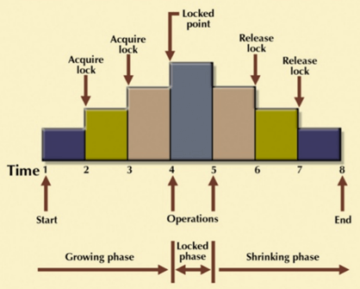
Strict-Two Phase Locking Method (2PL)
2PL ensures serializability by applying a lock to the transaction data which blocks other transactions to access the same data simultaneously.
Growing Phase
Shrinking Phase
Transaction Execution Phases
First Phase: Acquire Locks
2nd Phase: Complete transaction.
3rd Phase: Release Locks. Cant obtain any more locks during this phase.

Slide 22
Types of 2PL
Strict Two-Phase Locking Method
Strict-Two phase locking system is almost similar to 2PL. The only difference is that Strict-2PL never releases a lock after using it. It holds all the locks until the commit point and releases all the locks at one go when the process is over.
Centralized 2PL
In Centralized 2 PL, a single site is responsible for lock management process. It has only one lock manager for the entire DBMS.
Primary copy 2PL
Primary copy 2PL mechanism, many lock managers are distributed to different sites. After that, a particular lock manager is responsible for managing the lock for a set of data items. When the primary copy has been updated, the change is propagated to the slaves.
Distributed 2PL
In this kind of two-phase locking mechanism, Lock managers are distributed to all sites. They are responsible for managing locks for data at that site. If no data is replicated, it is equivalent to primary copy 2PL. Communication costs of Distributed 2PL are quite higher than primary copy 2PL

Slide 23
TimeStamp based Protocol
This algorithm uses System Time or Logical Counter as a timestamp to serialize the execution of concurrent transactions.
ensures that every conflicting read and write operations are executed in a timestamp order.
The older transaction are given priority. This is the most commonly used concurrency protocol.

Slide 24
Validation Based Protocol
Validation based Protocol also known as Optimistic Concurrency Control Technique.
In this protocol, the local copies of the transaction data are updated rather than the data itself, which results in less interference while execution of the transaction.
The Validation based Protocol is performed in the following three phases:
Read Phase
Validation Phase
Write Phase

Slide 25
VBP
Read Phase
In the Read Phase, the data values from the database can be read by a transaction but the write operation or updates are only applied to the local data copies, not the actual database.
Validation Phase
In Validation Phase, the data is checked to ensure that there is no violation of serializability while applying the transaction updates to the database.
Write Phase
In the Write Phase, the updates are applied to the database if the validation is successful, else; the updates are not applied, and the transaction is rolled back.

